Slide 1
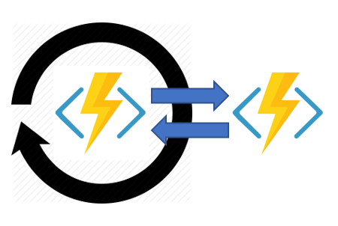

Serverless Orchestration with Azure Durable Functions

Slide 2

Hello!
I am Alec Trievel
You can find me on GitHub:
@atrievel

Slide 3
Agenda
Intro
Why serverless?
Challenges of serverless composition
Why use Azure Durable Functions?
Design patterns and concepts
Pitfalls
Demos
Q & A

Slide 4
1.
Why Serverless?
Let’s start with a brief history lesson

Slide 5
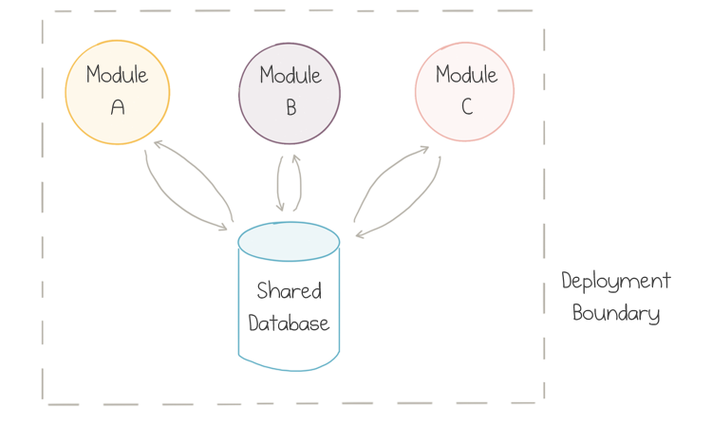
Monolithic
Notes:
Packaged as one single unit
Teams own each component
Great for small to medium sized applications
Loosely coupled except around database
Hard to scale

Slide 6
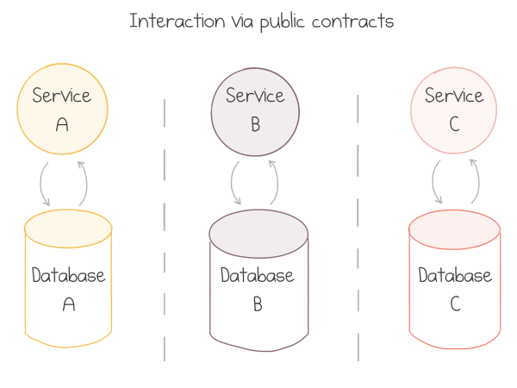
Microservices
Notes:
Complex, yet viable “reaction” to monolith
Idea was that each business unit had its own “slice” and communicated via contracts
No shared DBs!

Slide 7
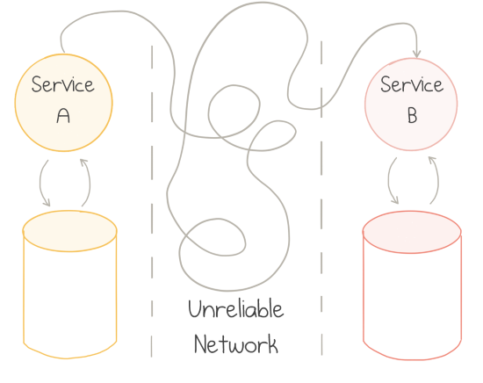
Microservices
Notes:
Networks are fundamentally unreliable: they fail in all kinds of unpredictable and least desirable manners
System is potentially brittle
Distributed systems are hard - where should we slice?
Service B is unhealthy, could slow service A down as well

Slide 8
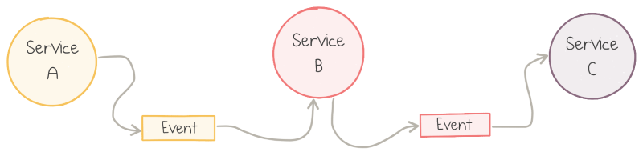
Event Driven
Notes:
Your basic async/await style
Service publishes an event when it does something useful
Each service doesn’t need to know about who consumes it’s events!
System won’t catch fire if a service goes down
Easy to stop seeing the forest for the trees (low cohesion)

Slide 9
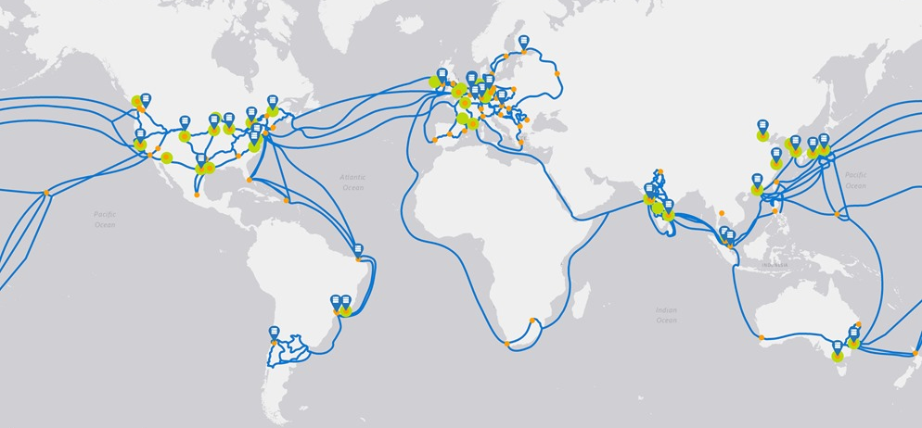
Cloud
Notes:
Public cloud changed the way we architect applications
Provisioning of new resources, scaling elastically based on demand, and resiliency and disaster recovery
Public Cloud is the ultimate distributed system. As you remember, distributed systems are hard!
Providers offer off-the-shelf solutions to common complex problems

Slide 10
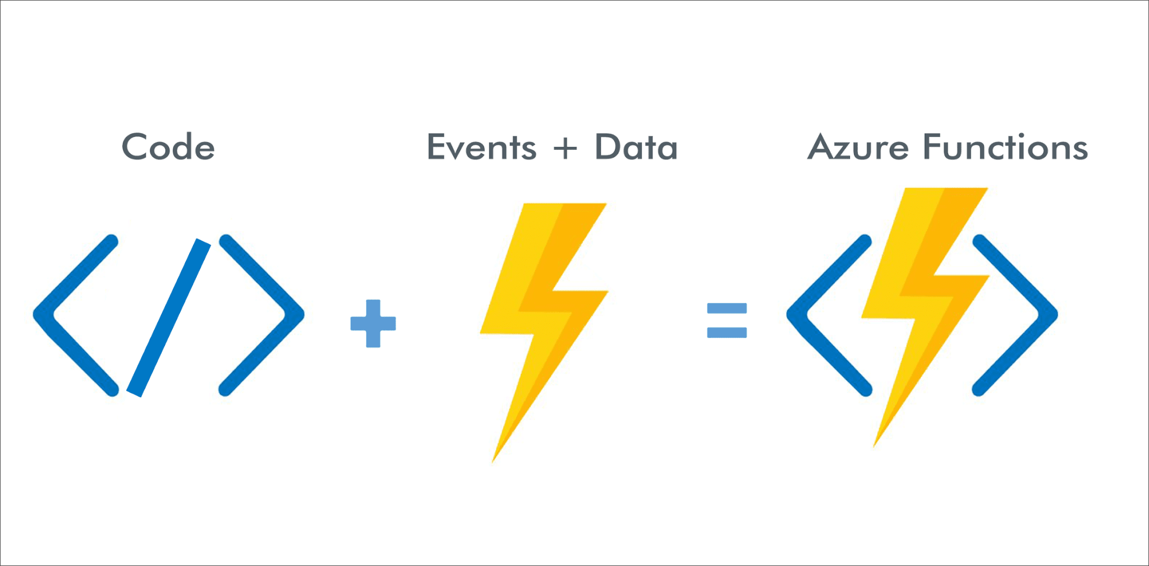
Serverless
Notes:
Servers are someone else’s problem - focus on code, not plumbing (more fun for developers!)
Pay to use (compute) model, basically an electric bill
You do lose some control over the resources
The infrastructure automatically scales up or down based on demand, and you pay per request, CPU time and memory that the application consumed. No usage—no bill
Azure Functions
Should do one, small, short task (single responsibility principle)
FaaS (function as a service)
Event driven - for each serverless function you have to define a specific trigger—the event type which causes it to run, be it an HTTP endpoint or a queue message
Short-Lived - functions can only run up to several minutes, and preferably for a few seconds or less
Stateless - as you don't control where and when function instances are provisioned or deprovisioned, there is no way to store data within the process between requests reliably; external storage has to be utilized.
Scalable
Essentially nanoservices - still losing the big picture

Slide 11
2.
Challenges with Serverless Design
The stuff that’s still difficult

Slide 12
What’s Still Difficult?
Challenges:
Flexible sequencing
Error handling
Parallel actions
Polling / monitoring
External sources
Stateless needs to be:
Event driven
Stateless
Short lived
Scalable
We’re missing something to manage all these issues...
Notes:
Flexible sequencing
Functions wired one after the other, output is input of next function
Swapping function order would require potentially major code overhaul
Not decoupled
Error handling
A service becomes unhealthy, async retries implemented via a queue
Usually this retry happens immediately
Maybe we want a back-off policy where we try in an hour or so, but we are now stateful
Parallel actions
Fan in (hard) / fan out (easy)
Process might not need to go in order
In theory, both functions should subscribe to the same event and act on it independently (pub-sub event bus)
Functions can't be triggered by two events, let alone correlate two related events
Solution: write two functions, one per event. Use shared storage to save the output, last finishing function reads this data
Too much custom code, and the complexity rises linearly as the number of parallel actions increases
Race conditions? Error/retry logic?
Polling / monitoring
Can’t have a function running for hours
Could use a regular timer, but its interval is static and managing instance lifetimes becomes complex
Durables can be used to create flexible recurrence intervals, manage task lifetimes, and create multiple monitor processes from a single orchestration
External sources
Long-running, IoT, Human interaction
Involving humans in an automated process is tricky because people aren't as highly available and as responsive as cloud services
Create a timer to escalate to a manager for example, then listen for result of interaction

Slide 13
3.
Why Azure Durable Functions?
Orchestrator to the rescue!

Slide 14
Stateful workflows on top of stateless serverless cloud functions
Notes:
We needed an additional tool to organize low-level single-purpose independent functions into high-level workflows
An orchestrator’s sole mission is to delegate work to stateless actions while maintaining the big picture and history of the flow

Slide 15
Durable Functions
A library that brings workflow orchestration abstractions to Azure Functions
Records the history of all actions in Azure Storage services
Stateful workflows authored in code
Notes:
Introduces a number of idioms and tools to define stateful, potentially long-running operations, and manages a lot of mechanics of reliable communication and state management behind the scenes
Enabling durability and resilience to failures
No JSON schemas or designers
They can synchronously and asynchronously call other functions and save output to local variables.
Local state is never lost if the process recycles or the VM reboots
They automatically checkpoint their progress whenever the function awaits

Slide 16
Client Functions
Entry point for creating an instance of a Durable Functions orchestration
[FunctionName("QueueStart")]
public static Task Run(
[HttpTrigger("place-order-trigger-func")] string cart,
[OrchestrationClient] DurableOrchestrationClient starter)
{
return starter.StartNewAsync("ProcessOrder", cart);
}
Notes:
Used to:
Start them - StartNewAsync
Query their status - GetStatusAsync
Terminate them - TerminateAsync
Send events to them while they're running - RaiseEventAsync
Purge instance history - PurgeInstanceHistoryAsync

Slide 17
Orchestrator Functions
Sole purpose is to manage the flow of execution and data among several activity functions
[FunctionName("SequentialWorkflow")]
public static async Task SequentialWorkflow(
[OrchestrationTrigger] DurableOrchestrationContext context,
Cart cart)
{
var products = await context
.CallActivityAsync<Product>("GetProducts", cart);
var order = await context
.CallActivityAsync<Order>("PlaceOrder", products);
await context.CallActivityAsync("ShipOrder", order);
}
Notes:
Many different types of actions, including activity functions, sub-orchestrations, waiting for external events, and timers
Must be triggered by an orchestration trigger

Slide 18
Activity Functions
Stateless single-purpose building blocks
Basic unit of work
Activity Functions can do pretty much anything
[FunctionName("PlaceOrder")]
public static Order PlaceOrder(
[ActivityTrigger] string productId)
{
var order = OrderService.Create(productId);
return new Order { OrderId = Guid.NewGuid()};
}
Notes:
Do just one task and have no awareness of the bigger workflow
The ActivityTrigger attribute defines the trigger type and points to the input parameter conference which the activity expects to get for each invocation
The function can return a result of any serializable type, even tuples or arrays for large data types
They can call other services, load and save data from/to databases, and use any .NET libraries

Slide 19
Sub-Orchestrations
[FunctionName("CombinedOrchestrator")]
public static async Task CombinedOrchestrator(
[OrchestrationTrigger] DurableOrchestrationContext context)
{
var orders = await context
.CallSubOrchestratorAsync("GetOrders", productID);
await context
.CallSubOrchestratorWithRetryAsync("ShipOrders", orders);
}
Notes:
Orchestrator can call other orchestrators
Useful for large libraries
Useful for running the same orchestrator in parallel

Slide 20
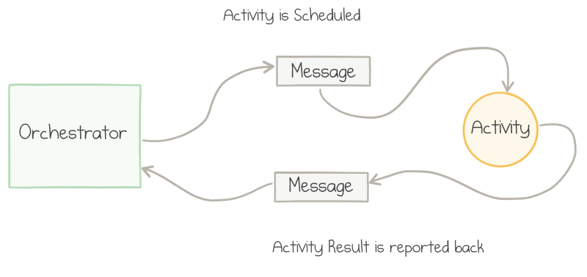
Under the Hood
Notes:
First, orchestrator uses the CallActivityAsync method to send a queue message to the activity function and goes to sleep
Second, Activity function completes its job, serializes the rest, and returns this as queued message
Lastly, orchestrator is triggered again and grabs the serialized result from the queue
Event sourcing - cloud design pattern
Require some form of state to keep track of progress
Everytime an event happens, it is logged in Azure Table Storage
Each time the orchestrator is called, it reads the complete history and makes decisions on what to run next
Durability—if a host running an orchestration fails, the history is retained in persistent storage and is loaded by the new host where the orchestration restarts;
Scalability—append-only writes are fast and easy to spread over multiple storage servers;
Observability—no history is ever lost, so it's straightforward to inspect and analyze even after the workflow is complete.

Slide 21
Error Handling and Retries
Activity functions “notify” orchestrator on failure
Developer is free to have backup logic
Error could be transient and we want to retry
var options = new RetryOptions(
firstRetryInterval: TimeSpan.FromMinutes(1),
maxNumberOfAttempts: 3);
options.BackoffCoefficient = 2.0;
await context
.CallActivityWithRetryAsync("PlaceOrder", options, productId);
Notes:
Backup logic - cancel and order, refund card, etc. Clean slate approach
The error might be transient (short lived, like API failure), so it might make sense to retry the failed operation after a pause
Code sample
Wait for one minute before retrying
Retry up to 3 times
Increase the delay before a subsequent retry by powers of 2 (2, 4, 8)

Slide 22
4.
Design Patterns
Templates for success

Slide 23
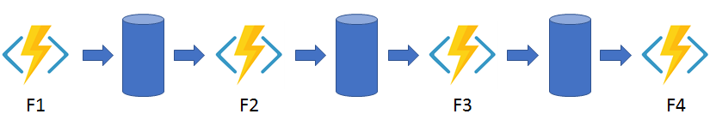
Function Chaining
Notes:
a sequence of functions executes in a specific order

Slide 24
Function Chaining
public static async Task<object> Run(
[OrchestrationTrigger] DurableOrchestrationContext context)
{
try
{
var x = await context.CallActivityAsync<object>("F1");
var y = await context.CallActivityAsync<object>("F2", x);
var z = await context.CallActivityAsync<object>("F3", y);
return await context.CallActivityAsync<object>("F4", z);
}
catch (Exception)
{
// Error handling or compensation goes here.
}
}

Slide 25
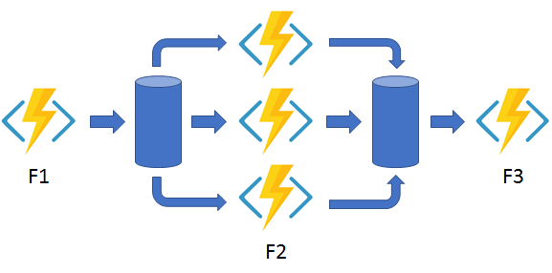
Fan-in / Fan-out
Notes:
Execute multiple functions in parallel and then wait for all functions to finish
Often, some aggregation work is done on the results that are returned from the functions
With normal functions, you can fan out by having the function send multiple messages to a queue
Fanning back in is much more challenging. To fan in, in a normal function, you write code to track when the queue-triggered functions end, and then store function outputs

Slide 26
Fan-in / Fan-out
public static async Task Run(
[OrchestrationTrigger] DurableOrchestrationContext context)
{
var shipmentEmails = new List<Task<Order>>();
List<Order> orders = await context.CallActivityAsync<List<Order>>("GetOrders");
foreach (var order in orders)
{
Task<string> task = context
.CallActivityAsync<int>("SendShipmentEmail", order);
shipmentEmails.Add(task);
}
await Task.WhenAll(shipmentEmails);
List<string> usaEmails= shipmentEmails.Where(t => t.Country == "USA");
await context.CallActivityAsync("MarketingData", usaEmails);
}

Slide 27
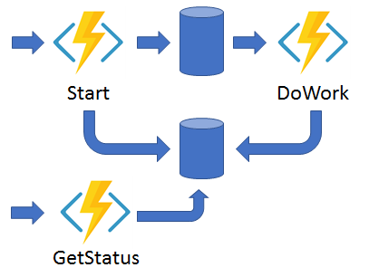
Async HTTP APIs
Notes:
Addresses the problem of coordinating the state of long-running operations with external clients
A common way to implement this pattern is by having an HTTP call trigger the long-running action
Then, redirect the client to a status endpoint that the client polls to learn when the operation is finished
Because the Durable Functions runtime manages state, you don't need to implement your own status-tracking mechanism

Slide 28
Async HTTP APIs
[FunctionName("StartNewOrchestration")]
public static async Task<HttpResponseMessage> Run(
[HttpTrigger] HttpRequestMessage req,
[OrchestrationClient] DurableOrchestrationClient starter,
string functionName,
ILogger log)
{
dynamic data = await req.Content.ReadAsAsync<object>();
string instanceId = await starter.StartNewAsync(functionName, data);
log.LogInformation($"Started orchestration with ID = '{instanceId}'.");
return starter.CreateCheckStatusResponse(req, instanceId);
}

Slide 29
Monitor
Notes:
The monitor pattern refers to a flexible, recurring process in a workflow
An example is polling until specific conditions are met
Regular timer triggers have static intervals in which they run
You can use Durable Functions to create flexible recurrence intervals, manage task lifetimes, and create multiple monitor processes from a single orchestration

Slide 30
Monitor
[FunctionName("Orchestrator")]
public static async Task Run(
[OrchestrationTrigger] DurableOrchestrationContext context)
{
float profit = context.GetInput<float>();
int pollingInterval = GetPollingInterval();
DateTime expiryTime = GetExpiryTime();
while (context.CurrentUtcDateTime < expiryTime)
{
await context.CallActivityAsync("SendProfitToAccounting", profit);
// Orchestration sleeps until this time.
var nextCheck = context.CurrentUtcDateTime.AddSeconds(pollingInterval);
await context.CreateTimer(nextCheck, CancellationToken.None);
}
}

Slide 31
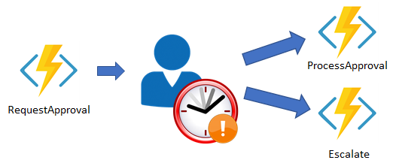
Human Interactions
Notes:
Involving humans in an automated process is tricky because people aren't as highly available and as responsive as cloud services
Could use a timer like the previous example
Expense report submitted by employee
Manager needs to approve, but if they forget, escalate it
Accounting needs to approve, but if they forget, escalate it

Slide 32
5.
Pitfalls
Stuff to avoid

Slide 33
Pitfalls
Orchestrator code must be deterministic
Orchestrator should be non-blocking
Avoid infinite loops and recursive fan-outs
Notes:
Everytime the orchestrator replays, code path could be different each time resulting in unexpected behavior
Use DurableOrchestrationContext.CurrentUtcDateTime
Use DurableOrchestrationContext.NewGuid()
Don’t use random values
No file I/O in orchestrators, but ok in Activity function. Never initiate async operation
Never really a good idea anyways
Use DurableOrchestrationContext.CountinueAsNew()
Takes snapshot and starts from beginning, but doesn’t have to redo the infinite loop
Same idea as infite

Slide 34
Billing
Same as Azure Functions
Free up to 1 million executions
Then $0.20 per million executions
Slight overhead with Azure Storage
Queues and tables
Beware of:
Eternal looping
Recursive fan-outs
Notes:
The stop-replay behavior of durable orchestrators causes the single workflow "instance" to execute the same orchestrator function multiple times. This also means paying for several short executions
However, the total bill usually ends up being much lower compared to the potential cost of blocking synchronous calls to activities. The price of 5 executions of 100 ms each is significantly lower than the cost of 1 execution of 30 seconds

Slide 35
Other Advice
Use AppInsights for monitoring
Function Apps have API endpoint for management
Versioning your functions
Ostrich algorithm
Wait for orchestrator to finish and drain
Side-by-side development
Notes:
Versioning - breaking changes can corrupt orchestration cycles
Do nothing and wait for the next cycle of the orchestrator to “fix” issues
-
Give task hub a unique name when deploying (recomended)

Slide 36
6.
Demo
Putting a bow on it

Slide 37
7.
Q & A
Questions and (hopefully) answers

